Slide 1

Machine Learning 23CS6PCMAL

Slide 2
Unit-4
Unit-4: Ensemble Techniques And Unsupervised Learning: Combining multiple learners: Model combination schemes, Voting, Ensemble Learning - bagging, boosting, stacking, Unsupervised learning: Introduction to Clustering, K-means clustering, Dimensionality reduction-Principal Component Analysis

Slide 3
What Is Ensemble Learning?
Ensemble learning is a machine learning technique that aggregates two or more learners in order to produce better predictions.
In other words, an ensemble model combines several individual models to produce more accurate predictions than a single model alone.
Base learner, base model, and, in some cases, base estimator refers to the individual model or models used in ensemble algorithms.
Ensemble learning rests on the principle that a collectivity of learners yields greater overall accuracy than an individual learner.

Slide 4
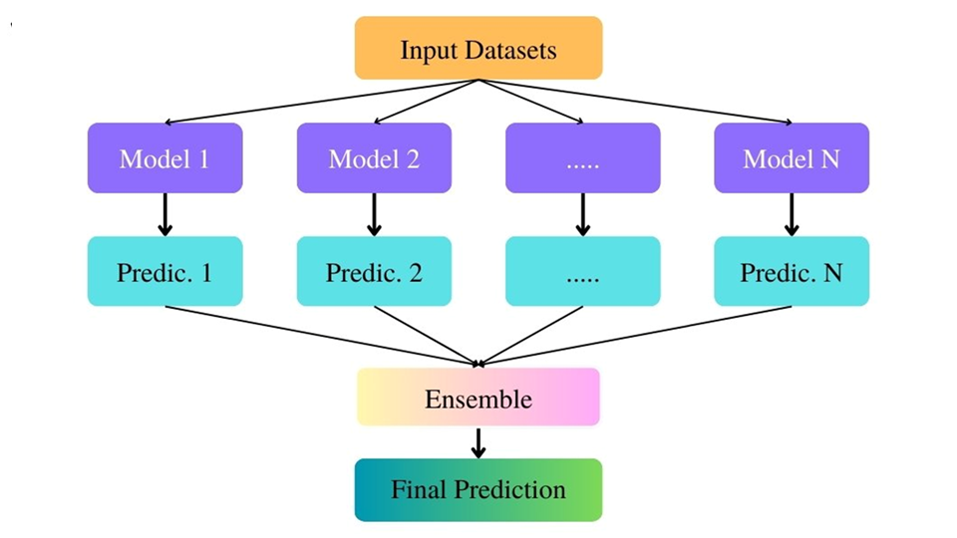
What Is Ensemble Learning?

Slide 5
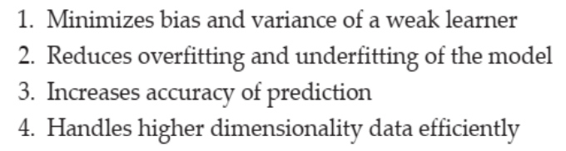
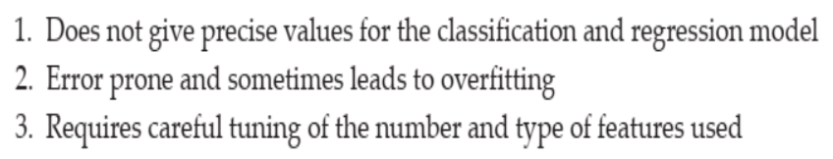
Ensemble Learning
Advantages
Disadvantages

Slide 6
Types of Ensemble Learning Methods
Literature widely categorizes ensemble learning methods in machine learning into two groups:
Parallel
Sequential.
Parallel methods train each base learner apart from the others of the others. Per its name, then, parallel ensembles train base learners in parallel and independent of one another.
Sequential methods train a new base learner so that it minimizes errors made by the previous model trained in the preceding step. In other words, sequential methods construct base models sequentially in stages.
Notes:
https://www.ibm.com/think/topics/ensemble-learning

Slide 7
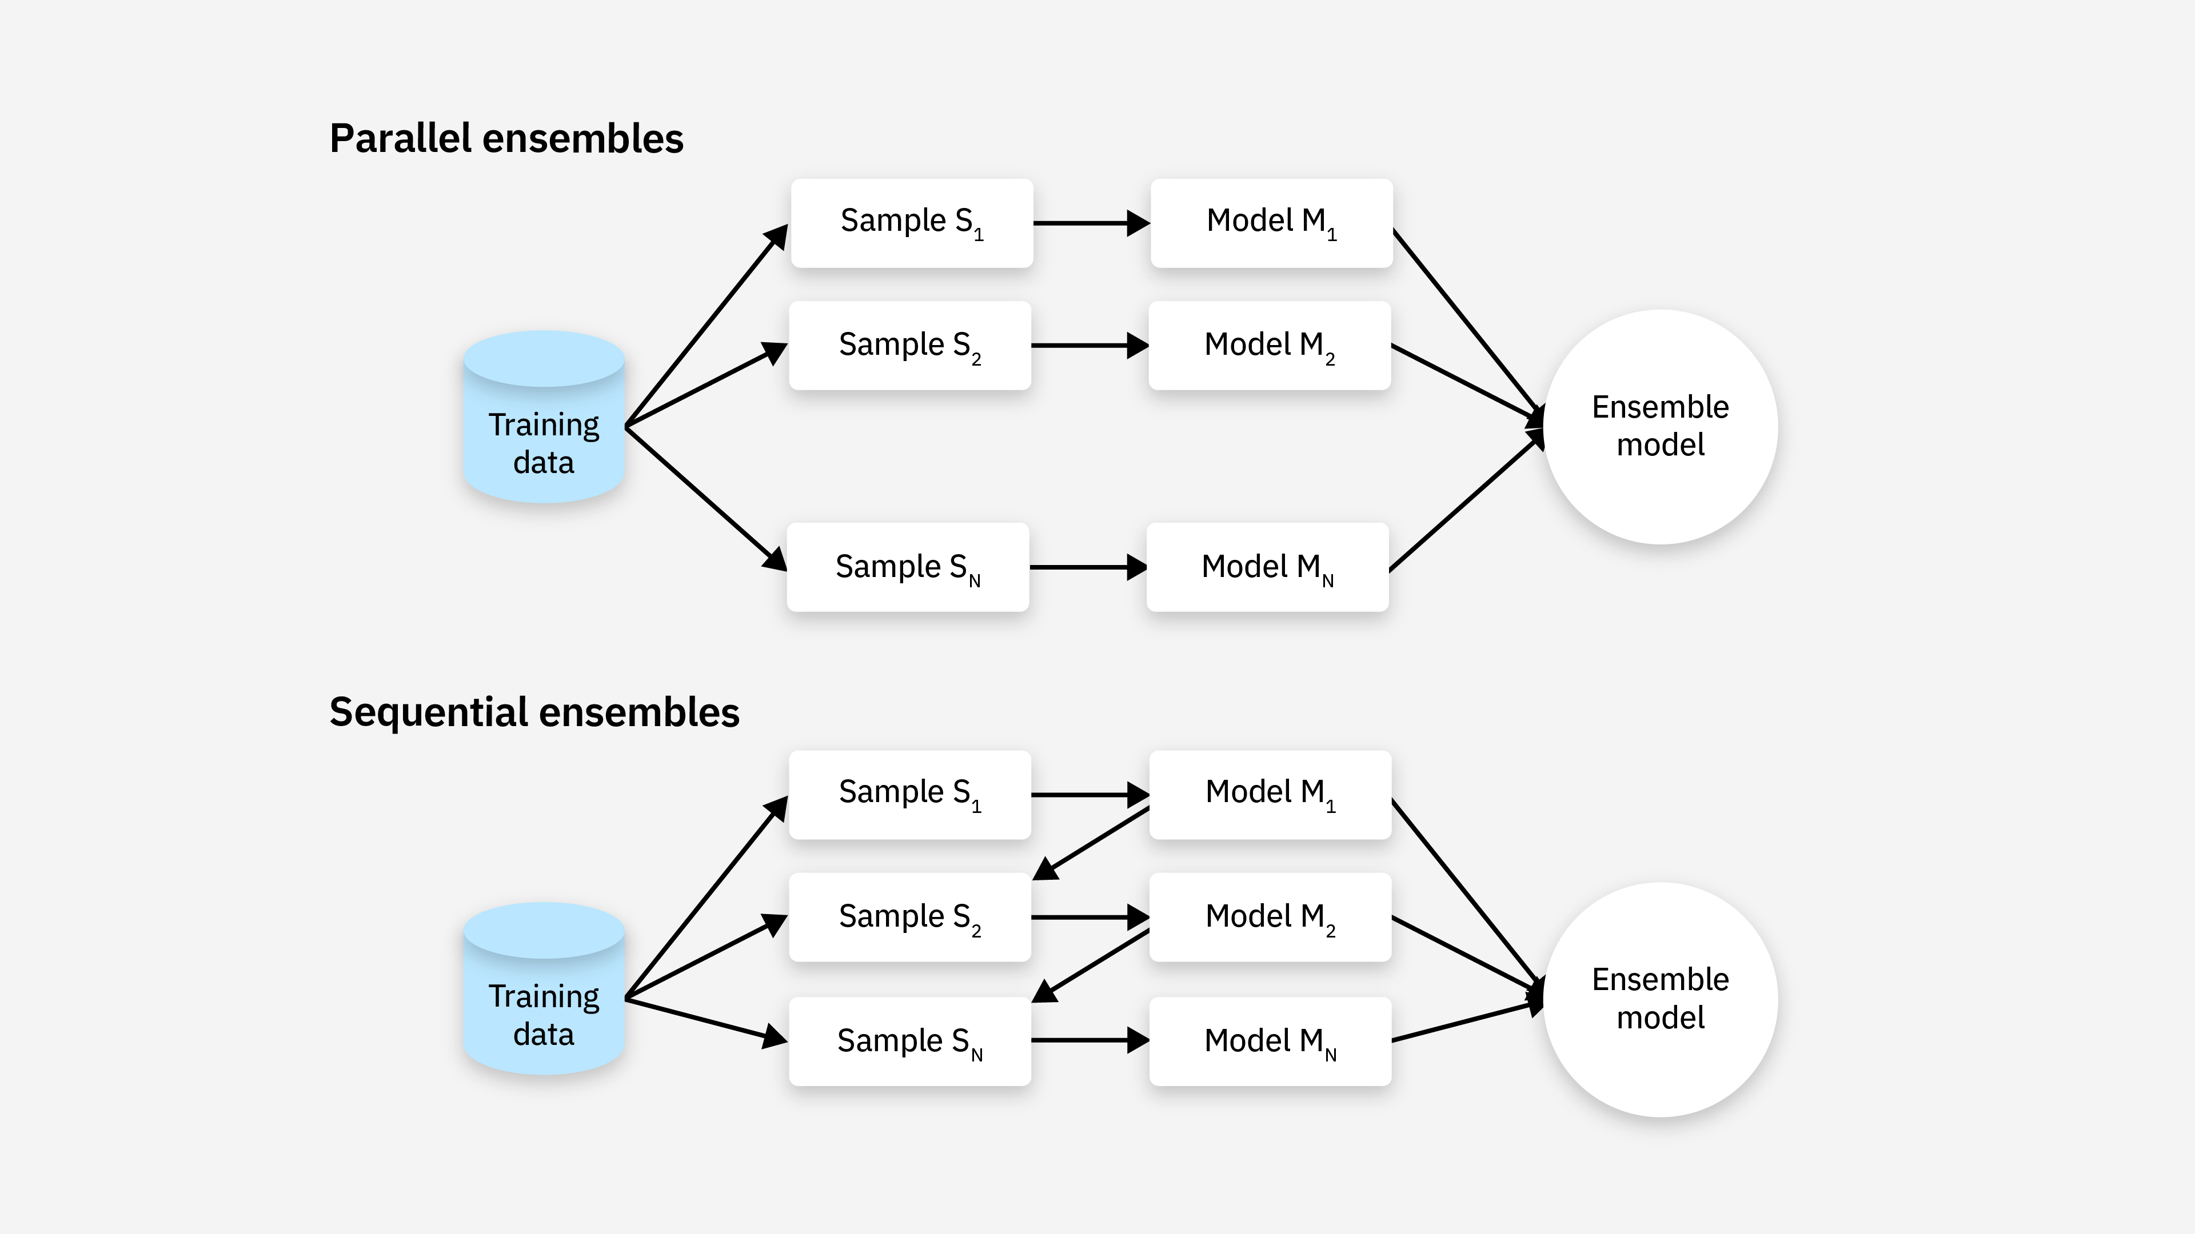
Types of Ensemble Learning Methods

Slide 8
Types of Ensemble Learning Methods
Parallel methods are further divided into
1. Homogenous Methods
2. Heterogenous Methods
Homogenous parallel ensembles use the same base learning algorithm to produce all of the component base learners.
Heterogenous parallel ensembles use different algorithms to produce base learners.

Slide 9
Voting
Two different ways to combine the predictions of multiple classifiers in ensemble machine learning algorithms.
Hard Voting
Soft Voting

Slide 10
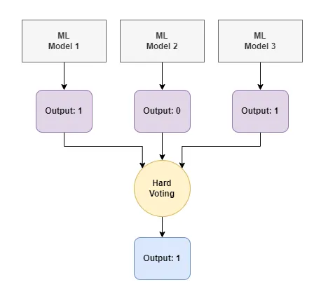
Hard Voting
Hard voting is the simplest approach. Each classifier makes a prediction, and the ensemble’s prediction is simply the majority vote.
For example, if three classifiers predict that an image is of a cat and one classifier predicts that it is of a deer, the ensemble’s prediction will be that the image is of a cat.

Slide 11
Hard Voting
Advantages of Hard Voting
Hard voting has several advantages over other ensemble learning algorithms.
First, it is very simple to implement.
Second, it is very effective.
Third, it can be used with any type of classifier.
Disadvantages of Hard Voting
First, it can be less accurate than soft voting, which takes into account the confidence of each classifier’s prediction. Second, hard voting can be less robust to noise in the data.

Slide 12
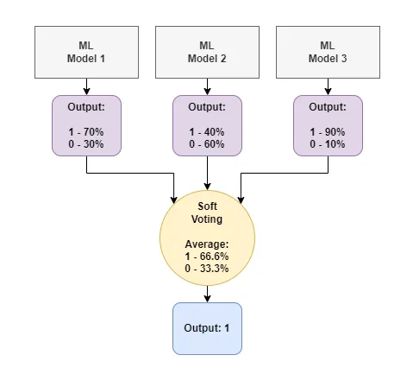
Soft Voting
Soft voting takes into account the confidence of each classifier’s prediction. Each classifier assigns a probability to each class, and the ensemble’s prediction is the class with the highest total probability.
For example, if one classifier predicts that an image is of a cat with a probability of 0.9 and another classifier predicts that it is of a deer with a probability of 0.1, the ensemble’s prediction will be that the image is of a cat.

Slide 13
Soft Voting
Advantages of Soft Voting
First, it is more accurate than hard voting.
Second, it is more robust to noise in the data.
Third, it can be used with any type of classifier.
Disadvantages of Soft Voting
First, it is more complex to implement than hard voting.
Second, it can be less efficient than hard voting. The complexity of soft voting is due to the fact that it requires each classifier to assign a probability to each class. This can be a time-consuming process, especially if there are a large number of classes.

Slide 14
Types of Ensemble learning techniques
Bagging
Boosting
Stacking

Slide 15
Bagging (Bootstrap Aggregating)
Bagging is a homogenous parallel method sometimes called bootstrap aggregating. It uses modified replicates of a given training data set to train multiple base learners with the same training algorithm.
Bagging leverages a technique called bootstrapping. Bootstrapping creates bootstrap samples, or we can say multiple training datasets, by sampling the original data with replacement. Replacement means that the same data point can be selected multiple times within a single bootstrap sample, unlike regular sampling, where an item is only chosen once.
Each bootstrap sample is then used to train a separate model, often called a base learner. These base learners can be any learning algorithm, but decision trees are commonly used.
Lastly, the outputs or features from these base learners are then combined to make a final prediction. This is done by either averaging the predictions for regression tasks or a majority vote for classification tasks.

Slide 16
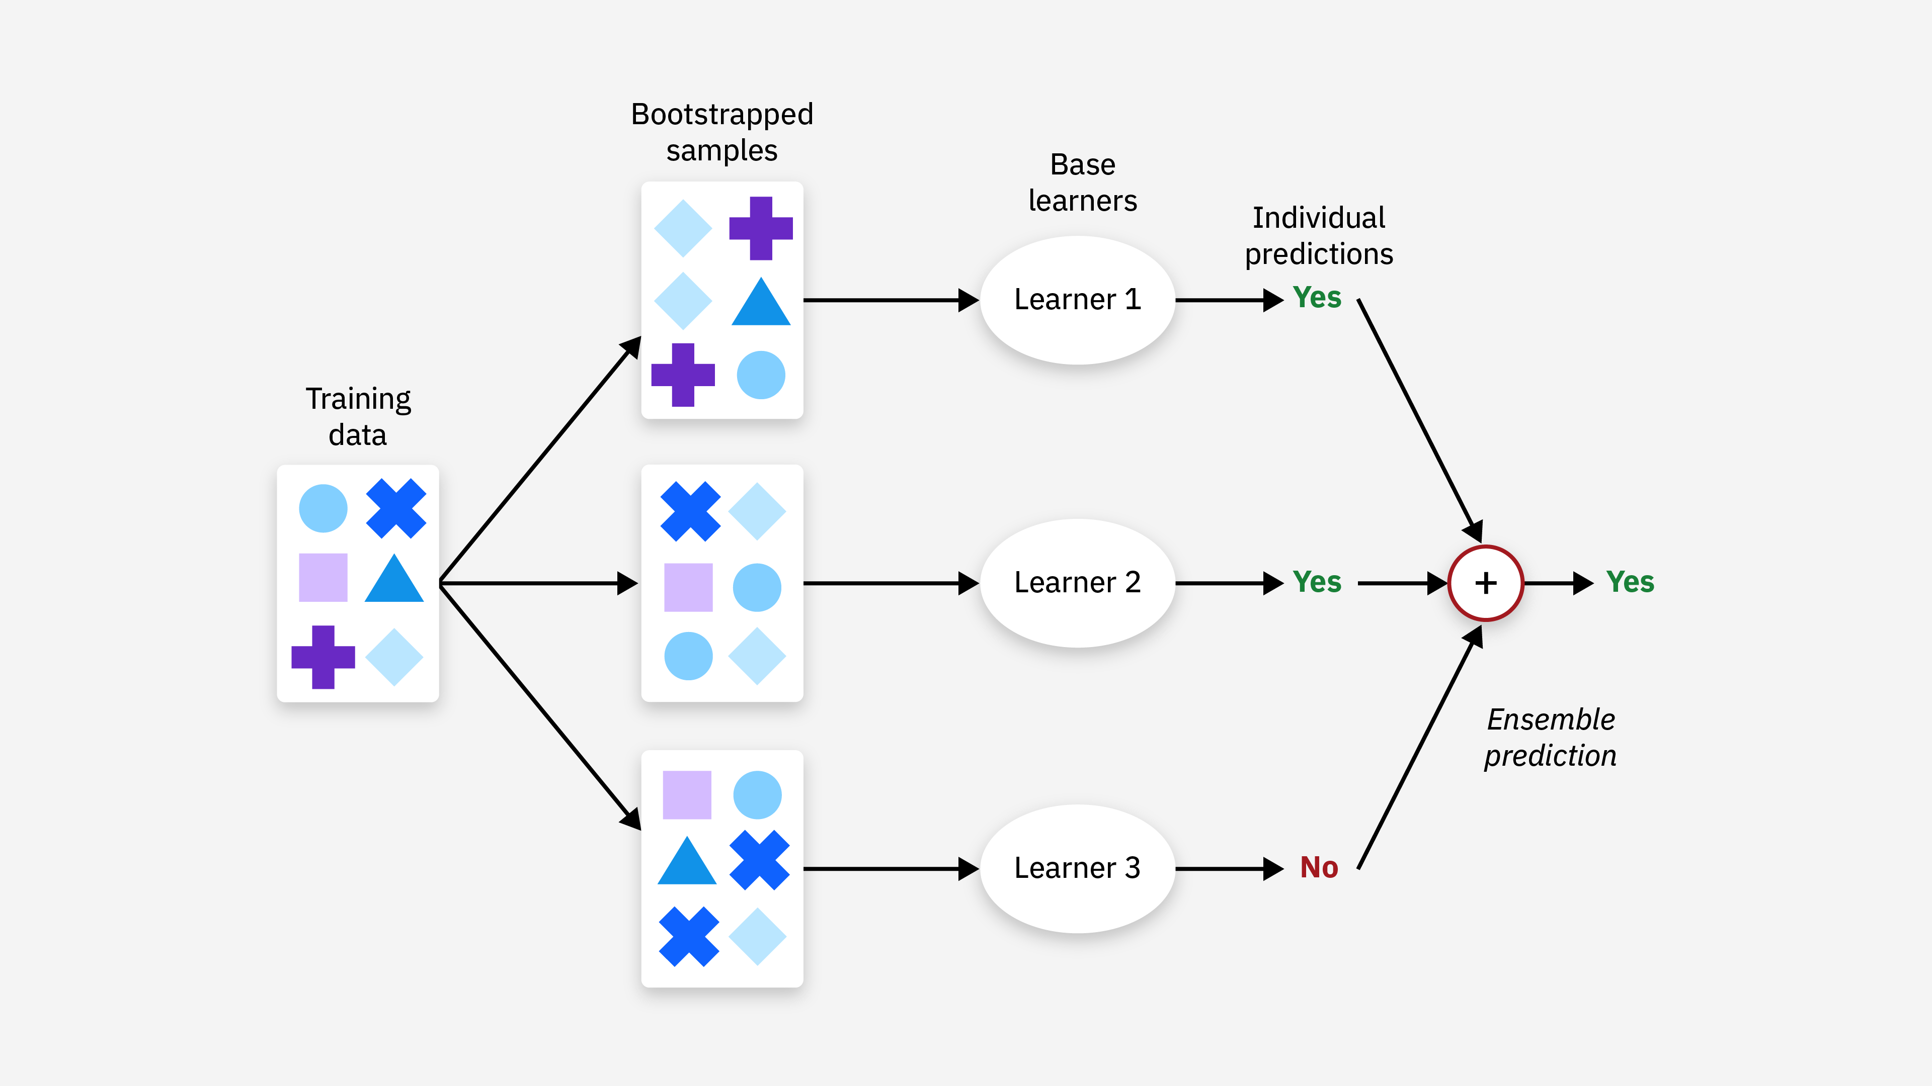
Bagging (Bootstrap Aggregating)

Slide 17
Bagging (Bootstrap Aggregating)
Benefits:
One of thе kеy bеnеfits of bagging is its ability to rеducе thе variance of prеdictions.
By rеducing variancе, bagging oftеn lеads to improvеd accuracy and gеnеralizability of thе modеl. This translatеs to a modеl that pеrforms wеll on thе training data as well as on unsееn data.
Limitations:
Bagging may not significantly improve models already with low variance.

Slide 18
Boosting
Boosting is a sequential ensemble method where weak learners (simple models) are built one after another. Each new model focuses on correcting the errors of the previous one. This iterative process helps to reduce overall bias.
Unlike bagging, where models are trained independently on different datasets, boosting trains models in sequence.
Each model works on rectifying errors made by the preceding model by assigning higher weights to misclassified data points during training.
Misclassified data points from the previous model receive more weight in the next iteration. This weighting, training, and adding of models are repeated iteratively for a specific number of times.
The final prediction comes from combining predictions of all individual models using a weighted voting method commonly applied in ensembles.

Slide 19
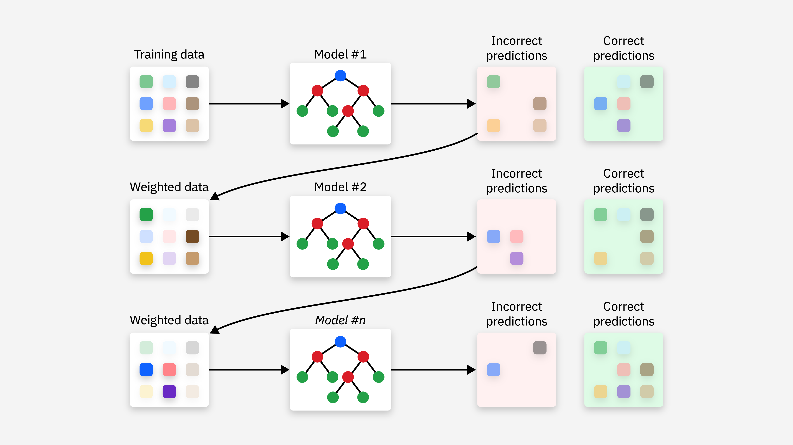
Boosting

Slide 20
Boosting
Benefits:
Boosting can notably decrease ensemble bias and
improve accuracy. Moreover, its iterative learning process
often allows for capturing more complex relationships
within data compared to individual models.
Limitations:
If boosting continues excessively over time, the ensemble
may become overly complex and overfitting training data,
leading to poor performance on unseen data as well.

Slide 21
Stacking
Stacking, or stacked generalization, is a heterogenous parallel method that exemplifies what is known as meta-learning.
Meta-learning consists of training a meta-learner from the output of multiple base learners.
Stacking specifically trains several base learners from the same dataset using a different training algorithm for each learner.
Each base learner makes predictions on an unseen dataset.
These first model predictions are then compiled and used to train a final model, being the meta-model.

Slide 22
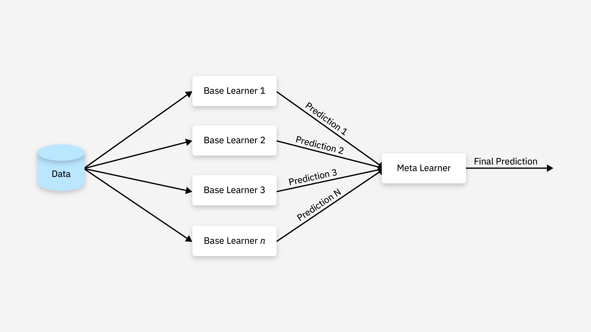
Stacking

Slide 23
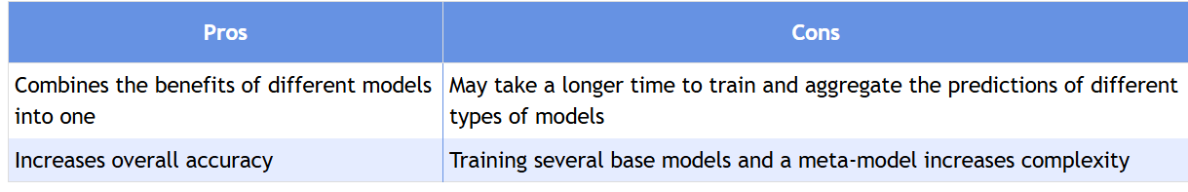
Stacking

Slide 24
Random Forest
Random forest is a modification of bagging that further improves the performance of the model by introducing randomness in the feature selection process.
In random forest, we create multiple decision trees using a subset of the original features. In each node of the tree, instead of using all the features, we randomly select a subset of features to split the data. This process is repeated for each node, resulting in a decision tree that uses a subset of the features.

Slide 25
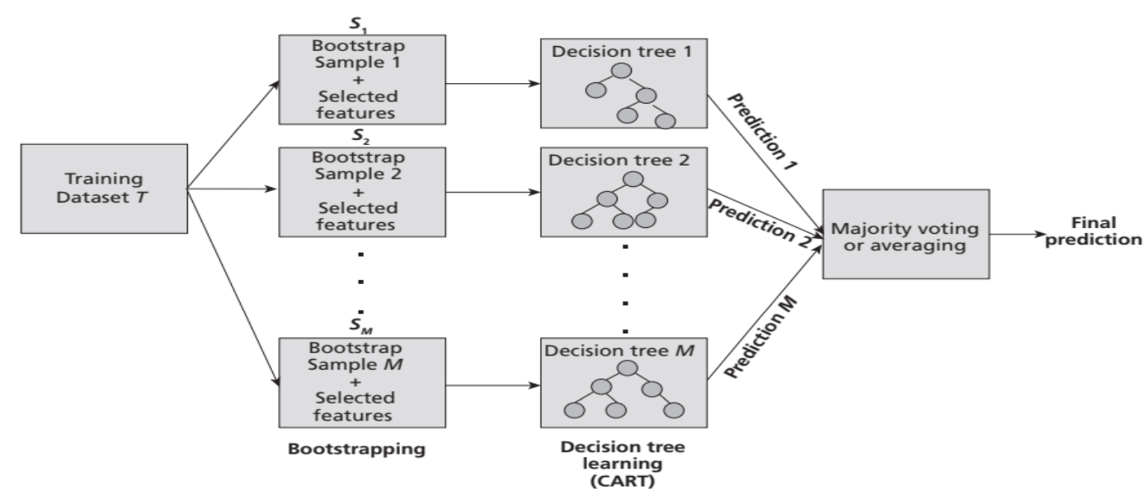
Random Forest Model

Slide 26
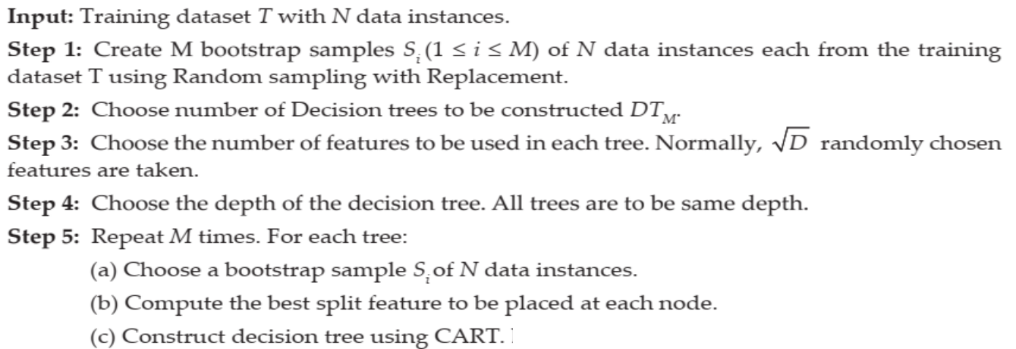
Random Forest Algorithm
Step 6: Combine predictions from all classifiers. For classification tasks, the forest
predicts by majority voting among trees, while for regression tasks, it averages the predictions
Notes:
For classification tasks, the forest predicts by majority voting among trees, while for regression tasks, it averages the predictions

Slide 27
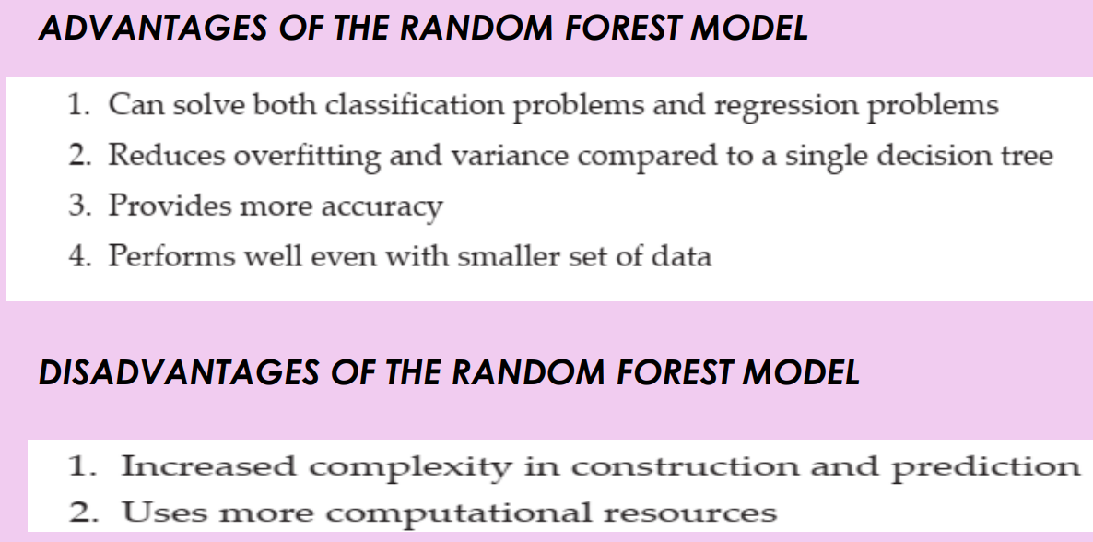
Random Forest

Slide 28
AdaBoost Algorithm
Idea behind AdaBoost Algorithm:
It iteratively trains a sequence of weak classifiers on different subsets of the training data.
During each iteration, the algorithm assigns higher weights to the misclassified samples from the previous iteration, thereby focusing on the more challenging examples.
This process allows the subsequent weak classifiers to pay more attention to the previously misclassified samples and improve their performance.

Slide 29
How does AdaBoost Work ?
Step 1: When the algorithm is given data, it starts by Assigning equal weights to all training examples in the dataset. These weights represent the importance of each sample during the training process.
Step 2: Here, this algorithm iterates with a few algorithms for a specified number of iterations (or until a stopping criterion is met). The algorithm trains a weak classifier on the training data. Here the weak classifier can be considered a model that performs slightly better than random guessing, such as a decision stump (a one-level decision tree).
Step 3: During each iteration, the algorithm trains the weak classifier on given training data with the current sample weights. The weak classifier aims to minimize the classification error, weighted by the sample weights.
Step 4.1: After training the weak classifier, the algorithm calculates classifier weight based on the errors of the weak classifier. A weak classifier with a lower error receives a higher weight.
Step 4.2: Once the calculation of weight completes, the algorithm updates sample weights, and the algorithm gives assigns higher weights to misclassified examples so that more importance in subsequent iterations can be given.
Step 5: After updating the sample weights, they are normalized so that they sum up to 1 and Combine the predictions of all weak classifiers using a weighted majority vote. The weights of the weak classifiers are considered when making the final prediction.
Step 6: Finally, Steps 2–5 are repeated for the specified number of iterations (or until the stopping criterion is met), with the sample weights updated at each iteration. The final prediction is obtained by aggregating the predictions of all weak classifiers based on their weights.

Slide 30
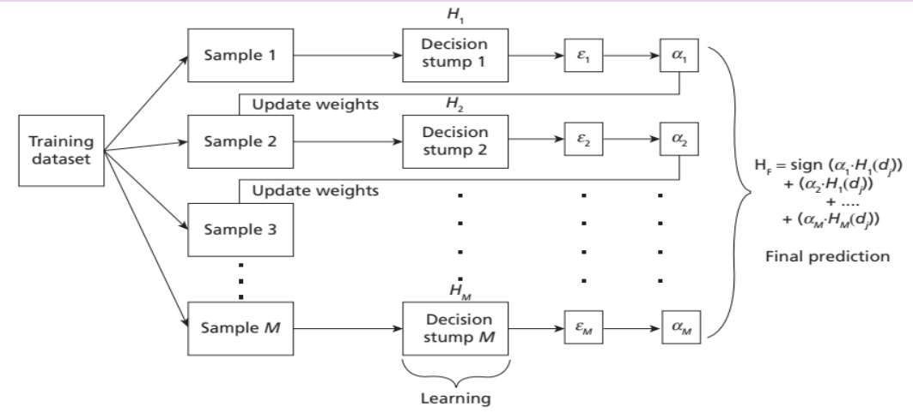
Working of AdaBoost Algorithm

Slide 31
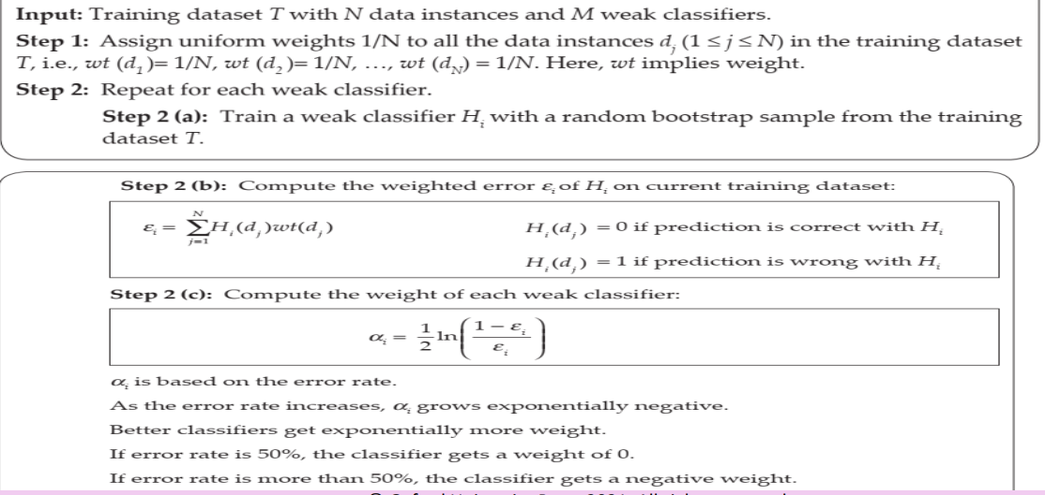
AdaBoost Algorithm

Slide 32
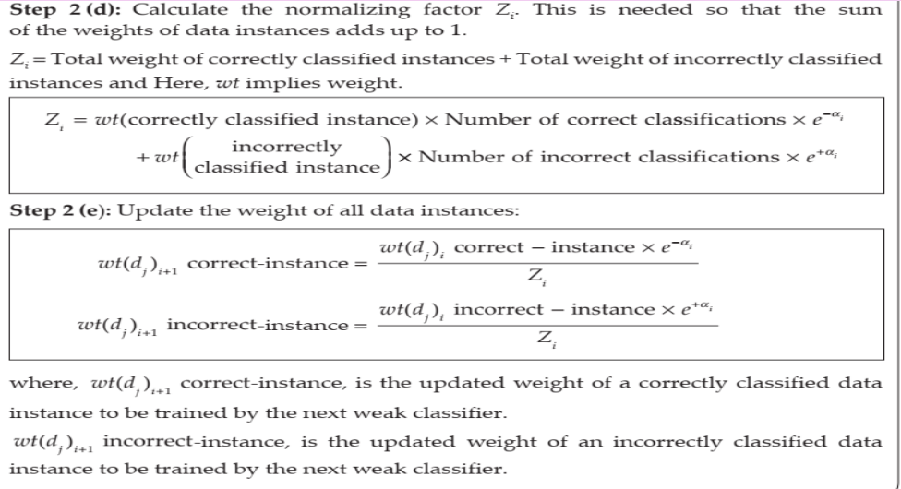
AdaBoost Algorithm

Slide 33
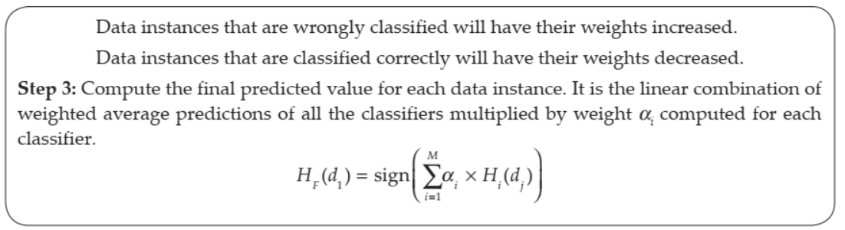
AdaBoost Algorithm (Contd…)

Slide 34
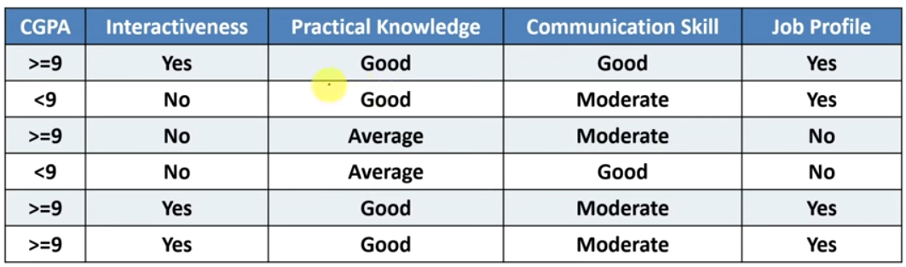
Question
Consider the following data set shown in Table. Apply the AdaBoost algorithm to train a classifier for the problem.

Slide 35
Consider four decision stumps DS(CGPA) , DS(Interactiveness) , DS(Practical Knowledge), and DS(Communication SKill) that classify the given data instances as positive and negative. For example, DS(CGPA) would classify a data instance as Positive if CGPA >= 9 and Negative if CGPA < 9.

Slide 36

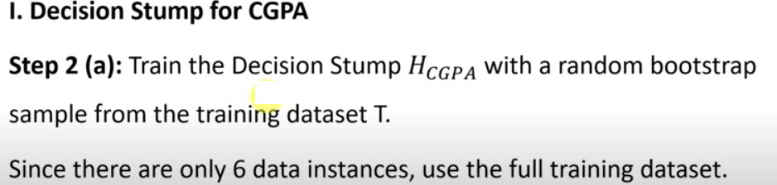

Slide 37
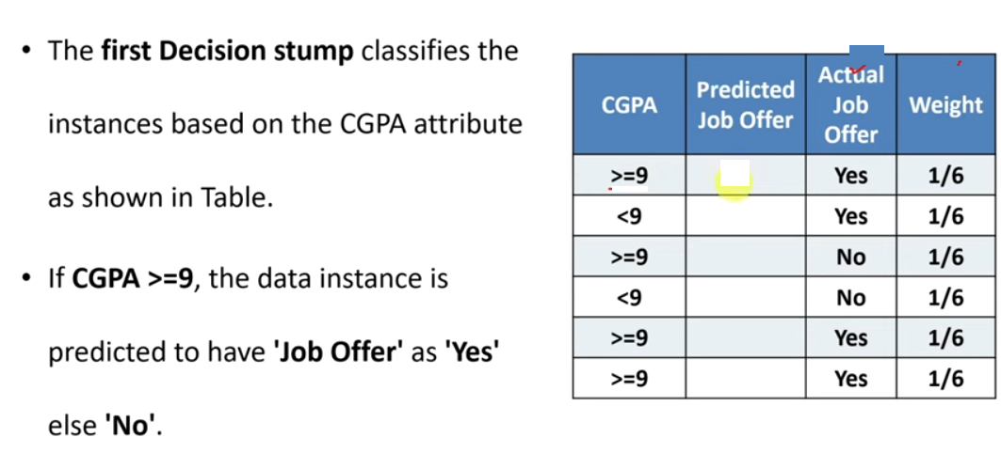

Slide 38
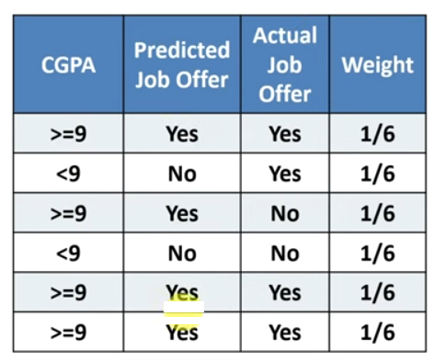
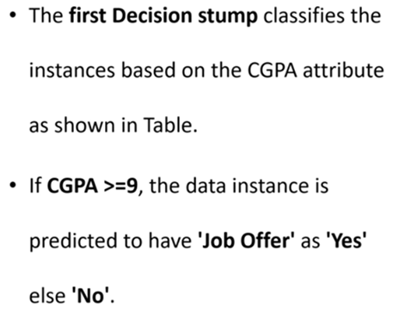

Slide 39
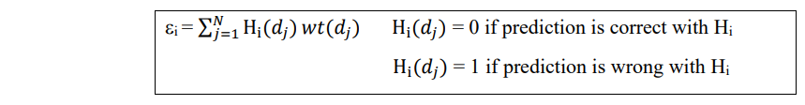
Step 2b: Compute the weighted error ε_{CGPA} of H_{CGPA} on current training data set T.

Slide 40
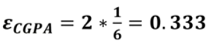
Step 2b: Compute the weighted error ε_{CGPA} of H_{CGPA} on current training data set T.

Slide 41
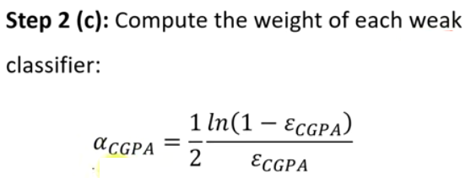

Slide 42
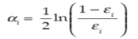
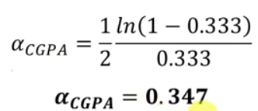
Consider the following Formula for
weight calculation

Slide 43
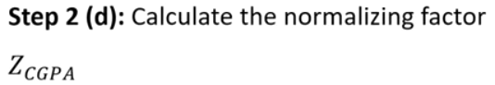

Slide 44
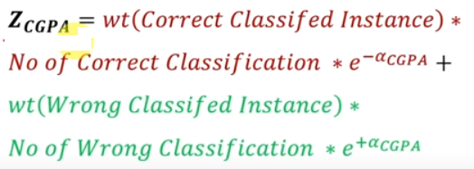

Slide 45
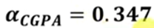
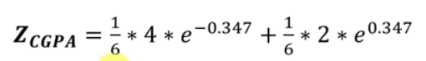
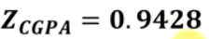

Slide 46
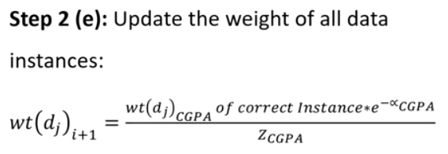
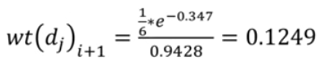

Slide 47
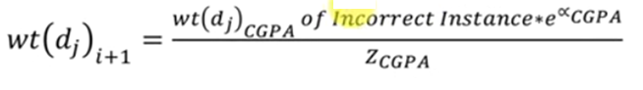
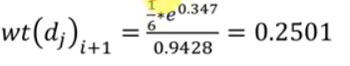

Slide 48
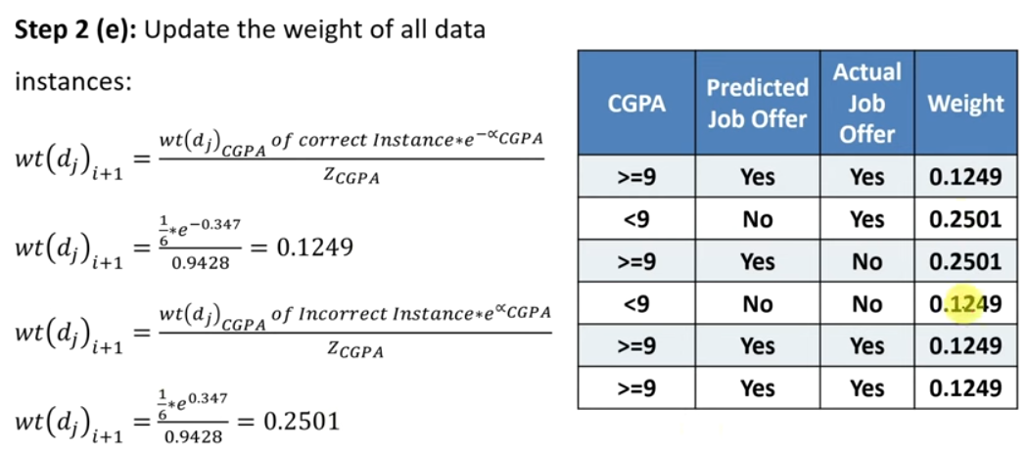

Slide 49
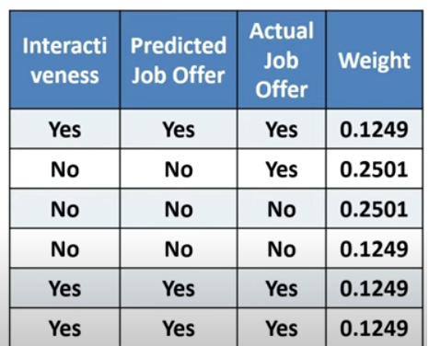
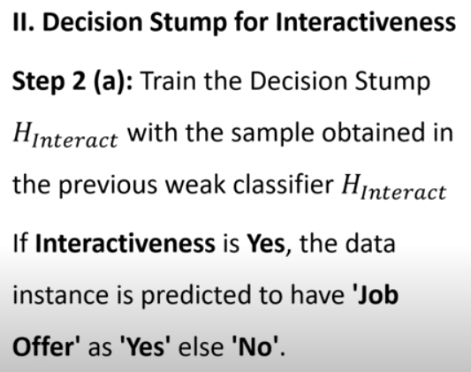

Slide 50
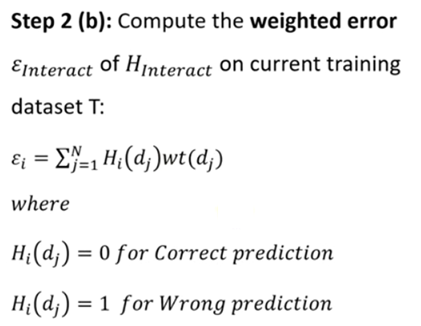

Slide 51
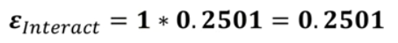

Slide 52
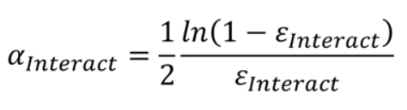
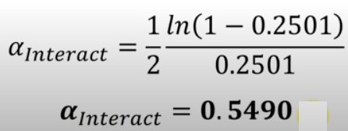
Consider the following Formula for
weight calculation

Slide 53
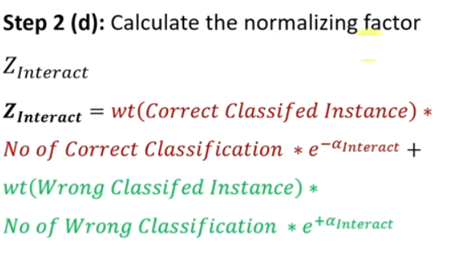

Slide 54
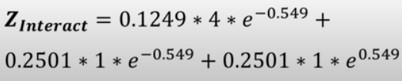
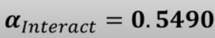

Slide 55
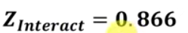

Slide 56
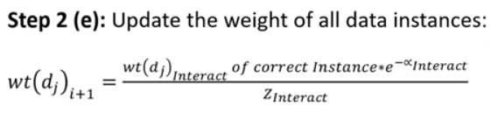

Slide 57
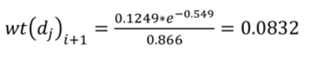
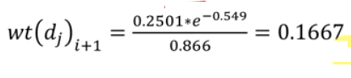

Slide 58



Slide 60


Slide 61


Slide 62



Slide 63


Slide 64


Slide 65




Slide 66


Consider the following Formula for
weight calculation

Slide 67





Slide 68



Slide 69



Slide 70

Yes
No
Yes
No
Yes
Yes

Slide 71
Unit-4
Unit-4: Ensemble Techniques And Unsupervised Learning: Combining multiple learners: Model combination schemes, Voting, Ensemble Learning - bagging, boosting, stacking, Unsupervised learning: Introduction to Clustering, K-means clustering, Dimensionality reduction-Principal Component Analysis

Slide 72

Unsupervised Learning
As the name suggests, unsupervised learning is a machine learning technique in which models are not supervised using training dataset. Instead, models itself find the hidden patterns and insights from the given data.
It can be compared to learning which takes place in the human brain while learning new things. It can be defined as:
“Unsupervised learning is a type of machine learning in which models are trained using unlabeled dataset and are allowed to act on that data without any supervision.”
Goal of unsupervised learning is to find the underlying structure of dataset and group that data according to similarities.
Notes:
Unsupervised learning cannot be directly applied to a regression or classification problem because unlike supervised learning, we have the input data but no corresponding output data.

Slide 73
Unsupervised Learning
Below are some main reasons which describe the importance of Unsupervised Learning:
o Unsupervised learning is helpful for finding useful insights from the data.
o Unsupervised learning is much similar as a human learns to think by their own experiences, which makes it closer to the real AI.
o Unsupervised learning works on unlabeled and uncategorized data which make unsupervised learning more important.
o In real-world, we do not always have input data with the corresponding output so to solve such cases, we need unsupervised learning.

Slide 74
Unsupervised Learning
Advantages of Unsupervised Learning
o Unsupervised learning is used for more complex tasks as compared to supervised learning because, in unsupervised learning, we don't have labeled input data.
o Unsupervised learning is preferable as it is easy to get unlabeled data in comparison to labeled data.
Disadvantages of Unsupervised Learning
o Unsupervised learning is intrinsically more difficult than supervised learning as it does not have corresponding output.
o The result of the unsupervised learning algorithm might be less accurate as input data is not labeled, and algorithms do not know the exact output in advance.

Slide 75
Unsupervised Learning
Unsupervised Learning can further be categorized as :
1. Clustering: Clustering in unsupervised machine learning is the process of grouping unlabeled data into clusters based on their similarities. The goal of clustering is to identify patterns and relationships in the data without any prior knowledge of the data’s meaning.
2. Association: Association rule learning is also known as association rule mining is a common technique used to discover associations in unsupervised machine learning. This technique is a rule-based ML technique that finds out some very useful relations between parameters of a large data set. This technique is basically used for market basket analysis that helps to better understand the relationship between different products.

Slide 76
Example of Clustering
Customer Segmentation: Grouping customers based on purchasing patterns, demographics, or online behavior to tailor marketing strategies and product offerings.
Image Segmentation: Dividing images into distinct regions or objects for analysis, such as in medical imaging or object recognition.
Social Network Analysis: Identifying communities or clusters of users with similar connections or interests.
Anomaly Detection: Identifying unusual patterns or outliers in data, which can be used for fraud detection, network intrusion detection, or equipment failure prediction.
Document Clustering: Organizing documents by topic or theme for efficient information retrieval and categorization.

Slide 77

Introduction to Clustering
Clustering is an unsupervised machine learning technique designed to group unlabeled examples based on their similarity to each other.
Data points clustered

Slide 78


Illustration for Clustering

Slide 79


K-Means Clustering Algorithm
One of the most used clustering algorithm is k-means.
It allows to group the data according to the existing similarities among them in k clusters, given as input to the algorithm.

Slide 80

K-Means Clustering Algorithm

Slide 81
Problem
Consider the following set of data given in Table. Cluster it using k-means algorithm with the initial value of objects 2 and 5 with the coordinate values (4,6) and (12,4) as initial seeds
Objects | X-Coordinate | Y-coordinate
1 | 2 | 4
2 | 4 | 6
3 | 6 | 8
4 | 10 | 4
5 | 12 | 4

Slide 82

Problem
For the given data, compute two clusters using K-means algorithm for clustering where initial cluster centers are (1.0, 1.0) and (5.0, 7.0). Execute for two iterations.

Slide 83


Solution
Number of clusters (K) = 2, centroid for cluster1 (C1)= (1.0, 1.0) and centroid for cluster2 (C2) = (5.0, 7.0). We use Euclidean distance to find closest point to centroids.

Slide 84

Solution

Slide 85
Problem
Cluster the following eight points (with (x, y) representing locations) into three clusters:
A1(2, 10), A2(2, 5), A3(8, 4), A4(5, 8), A5(7, 5), A6(6, 4), A7(1, 2), A8(4, 9)
Initial cluster centers are: A1(2, 10), A4(5, 8) and A7(1, 2).
The distance function between two points a = (x1, y1) and b = (x2, y2) is defined as-
Ρ(a, b) = |x2 – x1| + |y2 – y1|
Use K-Means Algorithm to find the three cluster centers after the second iteration.

Slide 86

Solution
Iteration1

Slide 87
Solution
Iteration1
We re-compute the new cluster clusters.
The new cluster center is computed by taking mean of all the points contained in that cluster.
For Cluster-01:
We have only one point A1(2, 10) in Cluster-01.
So, cluster center remains the same.
For Cluster-02:
Center of Cluster-02
= ((8 + 5 + 7 + 6 + 4)/5, (4 + 8 + 5 + 4 + 9)/5)
= (6, 6)
For Cluster-03:
Center of Cluster-03
= ((2 + 1)/2, (5 + 2)/2)
= (1.5, 3.5)
This is completion of Iteration-01.

Slide 88

Solution
Iteration2

Slide 89
Solution
Iteration2: From here, New clusters are-
Cluster-01:
First cluster contains points-
A1(2, 10) , A8(4, 9)
Cluster-02: Second cluster contains points-
A3(8, 4) , A4(5, 8) , A5(7, 5) , A6(6, 4)
Cluster-03: Third cluster contains points-
A2(2, 5) , A7(1, 2)
Now,
We re-compute the new cluster clusters.
The new cluster center is computed by taking mean of all the points contained in that cluster.
For Cluster-01: Center of Cluster-01
= ((2 + 4)/2, (10 + 9)/2) = (3, 9.5)
For Cluster-02: Center of Cluster-02
= ((8 + 5 + 7 + 6)/4, (4 + 8 + 5 + 4)/4) = (6.5, 5.25)
For Cluster-03: Center of Cluster-03
= ((2 + 1)/2, (5 + 2)/2) = (1.5, 3.5)
This is completion of Iteration-02.
After second iteration, the center of the three clusters are-
C1(3, 9.5) , C2(6.5, 5.25) , C3(1.5, 3.5)

Slide 90

Problem
Consider the following data shown in the following Table. Use k-means algorithm with k = 2 and show the result.

Slide 91
Elbow Method for optimal value of k in KMeans
Choosing the optimal number of clusters is a crucial step in any unsupervised learning algorithm. Since we don’t have predefined cluster counts in unsupervised learning, we need a systematic approach to determine the best k value.
The Elbow Method is a popular technique used for this purpose in K-Means clustering.

Slide 92

Elbow Method for optimal value of k in KMeans
The Elbow Method helps us find the optimal k value. Here’s how it works:
We iterate over a range of k values, typically from 1 to n (where n is a hyper-parameter you choose).
For each k, we calculate the Within-Cluster Sum of Squares (WCSS).

Slide 93

Elbow Method for optimal value of k in KMeans
In the Elbow Method, we systematically experiment with different numbers of clusters (K) ranging from 1 to 10.
With each K value, we compute the Within-Cluster Sum of Squares (WCSS). When we plot WCSS against K, the resulting graph resembles an elbow.
As we increase the number of clusters, the WCSS value begins to decrease.
When we see an elbow shape in the graph — where the curve noticeably bends or sharply decreases/increases — we pick the K value where the elbow gets created. We can call this the elbow point. Beyond the elbow point, increasing the value of ‘K’ does not lead to a significant reduction in WCSS.

Slide 94
Unit-4
Unit-4: Ensemble Techniques And Unsupervised Learning: Combining multiple learners: Model combination schemes, Voting, Ensemble Learning - bagging, boosting, stacking, Unsupervised learning: Introduction to Clustering, K-means clustering, Dimensionality reduction-Principal Component Analysis

Slide 95
Machine Learning –Bottlenecks
With the availability of high-performance CPUs and GPUs, it is pretty much possible to solve every regression, classification, clustering, and other related problems using machine learning and deep learning models.
However, there are still various portions that cause performance bottlenecks while developing such models.
A large number of features in the dataset are one of the major factors that affect both the training time as well as the accuracy of machine learning models.

Slide 96
The Curse of Dimensionality
In machine learning, “dimensionality” simply refers to the number of features (i.e. input variables) in your dataset.
While the performance of any machine learning model increases if we add additional features/dimensions, at some point a further insertion leads to performance degradation that is when the number of features is very large commensurate with the number of observations in your dataset, several linear algorithms strive hard to train efficient models. This is called the “Curse of Dimensionality”.

Slide 97
Dimensionality Reduction
Dimensionality Reduction is simply reducing the number of features (columns) while retaining maximum information

Slide 98
Dimensionality Reduction
Dimensionality Reduction helps in data compression, and hence reduced storage space.
It reduces computation time.
It also helps remove redundant features, if any.
Removes Correlated Features.
Reducing the dimensions of data to 2D or 3D may allow us to plot and visualize it precisely. You can then observe patterns more clearly.
It is helpful in noise removal also and as a result of that, we can improve the performance of models.

Slide 99

What is Dimensionality Reduction?
Dimensionality reduction is a key technique in data analysis and machine learning, designed to reduce the number of input variables or features in a dataset while preserving the most relevant information. In real-world datasets, the presence of numerous variables can increase complexity, make models prone to overfitting, and reduce interpretability.
Dimensionality reduction techniques tackle these challenges through the creation of new variables or projections that capture the data’s essential characteristics. The objective is to retain the underlying structure, patterns, and relationships within the data while working with fewer dimensions.
By reducing dimensionality, the data becomes easier to visualize, explore, and analyze, leading to faster computations, improved model performance, and clearer insights into the underlying factors driving the data.

Slide 100
Dimensionality Reduction Techniques
The various techniques used for dimensionality reduction include:
Principal Component Analysis (PCA)
Linear Discriminant Analysis (LDA)
Generalized Discriminant Analysis (GDA)
Multi-Dimension Scaling (MDS)
LLE
IsoMap
Autoencoders

Slide 101
What is Principal Component Analysis (PCA) ?
Principal component analysis, or PCA, is a dimensionality reduction method that is often used to reduce the dimensionality of large data sets, by transforming a large set of variables into a smaller one that still contains most of the information in the large set.

Slide 102

What is Principal Component ?
Principal components are new variables that are constructed as linear combinations or mixtures of the initial variables.
These combinations are done in such a way that the new variables (i.e., principal components) are uncorrelated and most of the information within the initial variables is squeezed or compressed into the first components.
So, the idea is 10-dimensional data gives you 10 principal components, but PCA tries to put maximum possible information in the first component, then maximum remaining information in the second and so on, until having something like shown in the scree plot below.

Slide 103
Principal Component Analysis (PCA)
PCA is a linear dimensionality reduction technique which converts a set of correlated features in the high dimensional space into a series of uncorrelated features in the low dimensional space.
These uncorrelated new features are also called principal components.
PCA is an orthogonal linear transformation which means that all the principal components are perpendicular to each other.
Each principal component captures a different aspect of the data’s variation.
They don’t repeat or overlap in the information they carry
It transforms the data in such a way that the first component tries to explain maximum variance from the original data

Slide 104



The main idea of PCA is to reduce the number of dimensions by finding principal components

Slide 105


City Vs Cost of Living
The following possibilities are available
X axis feature
Y axis feature
Green line
Yellow line
How to reduce to single dimension preserving as much information as possible?

Slide 106
The following possibilities are available
X axis feature
Y axis feature
Green line
Yellow line
We choose the one captures the more of the data

Slide 107


Variance of Single Feature
Variance Formula : Subtract the mean from all values and square them then summed up and divided by the number of variables
Variance is the measure for the spread of data
When the data points are far away from the center of the distribution then we have large variance
If they are closer to the center then we have smaller variance

Slide 108

Variance
Green line has more variance. Yellow line has small variance

Slide 109

Axis representation to understand the variance of data

Slide 110

Projecting 2D data into new axis by mapping original data into 1D. Axis1 capture the relationship of the features better

Slide 111

The below graph explains the variance of each Principal components
Keep the PC which captures more data and discard the PC which captures less data

Slide 112

PCA using Covariance Matrix
Principal Component Analysis (PCA) using the covariance matrix reduces data dimensionality by finding orthogonal vectors (principal components) that capture the most variance.
Covariance matrix tells us about the variance and joint direction of the variables.

Slide 113



Slightly higher variance of 1.3 for feature X2 and both the variables move in the same direction that is why covariance between variables also high
As like first example, variance for feature X2 is higher. Covariance is negative Trend
Slightly lower variance for each of the variables and no clear trend how they would move together therefore the covariance is quite low

Slide 114
Covariance value and interpretation
If both variables increase or decrease together, covariance is positive.
If one increases while the other decreases, covariance is negative.
If there’s no consistent relationship, covariance is near zero.

Slide 115
Steps for PCA
Data Preparation: Collect and preprocess your data.
Covariance Matrix Computation:
Compute the covariance matrix of your centered data. The covariance matrix describes the relationships between the different features in your dataset.
Eigenvalue and Eigenvector Computation:
Calculate the eigenvalues and eigenvectors of the covariance matrix. These represent the magnitude and direction of the principal components.
The eigenvalues indicate the variance explained by each principal component, and the eigenvectors define the direction of these components.

Slide 116
Steps for PCA
Sort Eigenvalues:
Sort the eigenvalues in descending order. The largest eigenvalues correspond to the most significant principal components.
Select Principal Components:
Decide how many principal components to keep. You can select a specific number or choose based on the explained variance (e.g., keep components that explain 95% of the variance).
Projection onto Principal Components:
Project your original data onto the selected principal components to obtain a new set of features (variables) that are linear combinations of the original features

Slide 117


The following are the data points or features given. Let us start with 4 data points

Slide 118


Covariance Matrix Computation

Slide 119




Slide 120


Eigen values Computation
find the roots of the quadratic equation for above equation

Slide 121
Calculate eigen vectors
To calculate this the initial step is to calculate the Characteristic Equation:
The characteristic equation for finding eigenvalues (λ) of a matrix C is given by:
det(S — λI) = 0
where:
S is the covariance matrix.
λ (lambda) represents the eigenvalues.
I is the identity matrix of the same dimensions as C.

Slide 122


Equating the above to vector 0, we will get the following

Slide 123


Taking the first equation into consideration
Consider the value of t as 1, the U vector or eigen vector will become

Slide 124

Sort Eigen Values
Whenever we want to calculate the principal components, we have to consider the largest eigen value. Here it is 8.37. To calculate the unit eigen vector , we have to calculate the length of U1.To obtain unit eigenvectors (eigenvectors with a magnitude of 1), we normalize the eigenvectors. To normalize a vector, divide each component by its magnitude (Euclidean norm).

Slide 125

The below represents the eigenvector corresponding to Principal component 2, if we are calculating PC2 we can consider the below eigenvector.

Slide 126


Select First Principal Component
The equation to calculate the principal component is as follows.
Applying the above equation on the first eigen vector we will get the following.

Slide 127





Projection onto Principal Components
Applying the equation on each data point.

Slide 128

Blue points are the data points, the red point is the average point, the yellow circle is the eigen vector point (-0.45,-0.89) and the green line is the first principal component.

Slide 129
Steps involved in PCA
Step 1: Standardize the dataset.
Step 2: Calculate the covariance matrix for the features in the dataset.
Step 3: Calculate the eigenvalues and eigenvectors for the covariance matrix.
Step 4: Sort eigenvalues and their corresponding eigenvectors.
Step 5: Pick k eigenvalues and form a matrix of eigenvectors.
Step 6: Transform the original matrix.

Slide 130

Problem
Given the data in table, reduce the dimension from 2 to 1 using the Principal Component Analysis (PCA).

Slide 131


Problem
Step1: Calculate mean

Slide 132



Slide 133


Slide 134



Step2: Calculation of
Covariance matrix

Slide 135


Step3: Eigenvalues of the covariance matrix

Slide 136

Step3: Eigenvalues of the covariance matrix
Solving Quadratic Equation:

Slide 137


Step4: Computation of Eigen vectors

Slide 138




Step4: Computation of Eigen vectors
Either consider first or second equation, we will consider first Equation.
We will solve for t=1

Slide 139


Slide 140




Slide 141




Slide 142


Slide 143
Thanks for Listening
Notes:
https://colab.research.google.com/github/ageron/handson-ml2/blob/master/02_end_to_end_machine_learning_project.ipynb#scrollTo=tLb7or7j1rMW

